Slide 1



AI Mental Health Therapist
With Google MedGemma LLM
Presented By:
1.Student Name : BIDISHA BISWAS
2.College Name : PARUL UNIVERSITY
3.Department : CSE (AI)

Slide 2

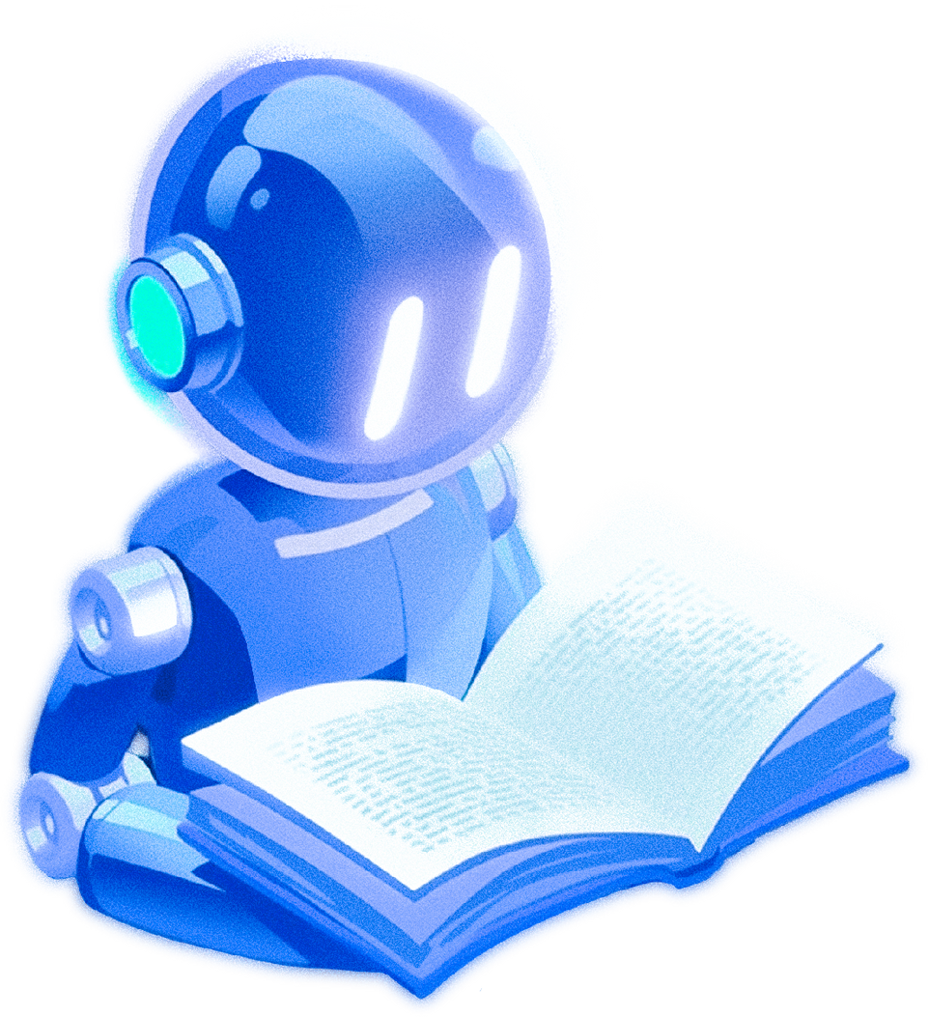
Table of Content
Problem Statement
Proposed System/Solution
System Development Approach
Project Structure
Code Setup
Algorithm & Deployment
Deployment & Execution
Execution Steps
Result
Conclusion
Future Scope
References

Slide 3
Problem Statement
Mental Health Companion Chatbot
Students face high levels of stress, anxiety, and loneliness but often hesitate to approach professional counselors. A safe, AI-driven chatbot that detects user mood through sentiment analysis and generates empathetic, motivational responses along with relaxation tips can support student mental well-being.

Slide 4

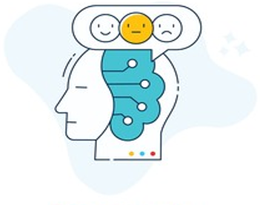


Proposed Solution
AI-Based Sentiment Analysis
Analyzes student chat data using NLP and machine learning models to identify emotional states such as stress, anxiety, and depression in real time.
Intelligent Response Generation
Employs pre-trained language models to generate empathetic, context-aware responses that support students’ emotional well-being.
.
Wellness Support & Emergency Intervention
Delivers evidence-based relaxation and mindfulness techniques and activates an emergency calling system when high-risk mental health indicators are detected.

Slide 5
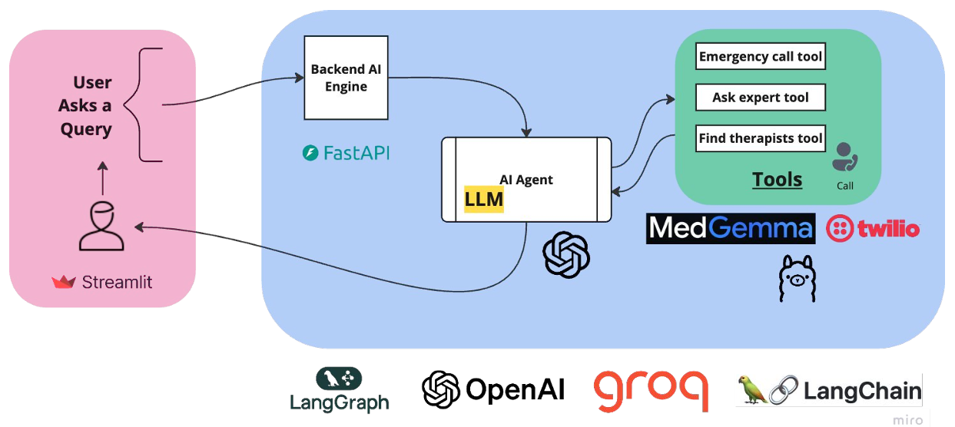
System Development Approach

Slide 6
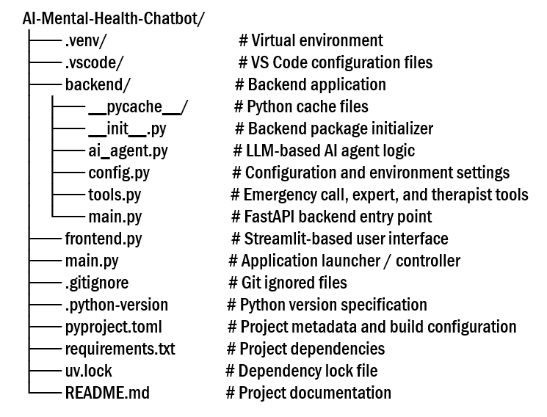
Project Structure

Slide 7

Code Setup
Phase 1: Frontend Setup:
Streamlit is used to build the chatbot user interface
Users can enter questions through the application
Responses received from the backend are displayed in real time
Phase 2: Backend Setup:
FastAPI is implemented as the backend framework
Backend receives and validates requests from the frontend
Processed responses are sent back to the frontend

Slide 8
Code Setup
Phase 3: AI Agent & Tools Setup:
Ollama is configured with the MedGemma model
Twilio Calling API is integrated for emergency communication
Location-based support tool is implemented
AI Agent is created and connected to the backend
Phase 4: System Integration & Testing:
All components are integrated into a single system
End-to-end testing is performed to verify functionality

Slide 9
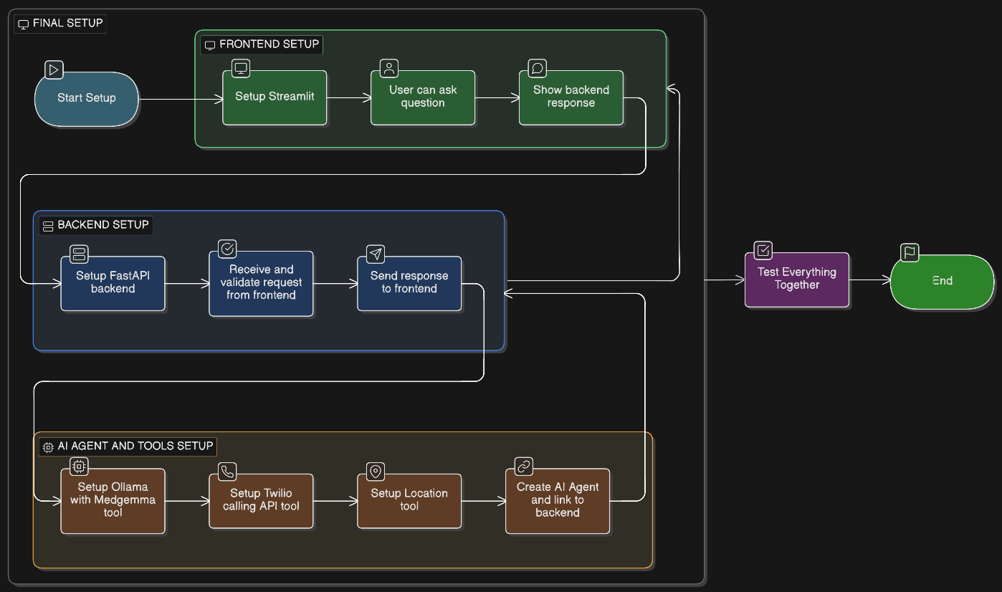
Algorithm & Deployment

Slide 10
Deployment & Execution
The complete project source code is hosted on GitHub for version control and easy access
Users can clone the repository and run the application locally
The project uses UV as the Python package and environment manager
GitHub Repository:
https://github.com/Bidisha03Biswas/AI-Mental-Health-Companion-Chatbot

Slide 11
Execution Steps
1. Install UV:
Download and install UV (Python package manager)
Used to manage dependencies and run the application efficiently
2. Run Backend (FastAPI):
Starts the FastAPI backend server
3. Run Frontend (Streamlit):
Launches the Streamlit-based chatbot interface
uv run uvicorn backend.main:app --reload
uv run streamlit run app.py

Slide 12
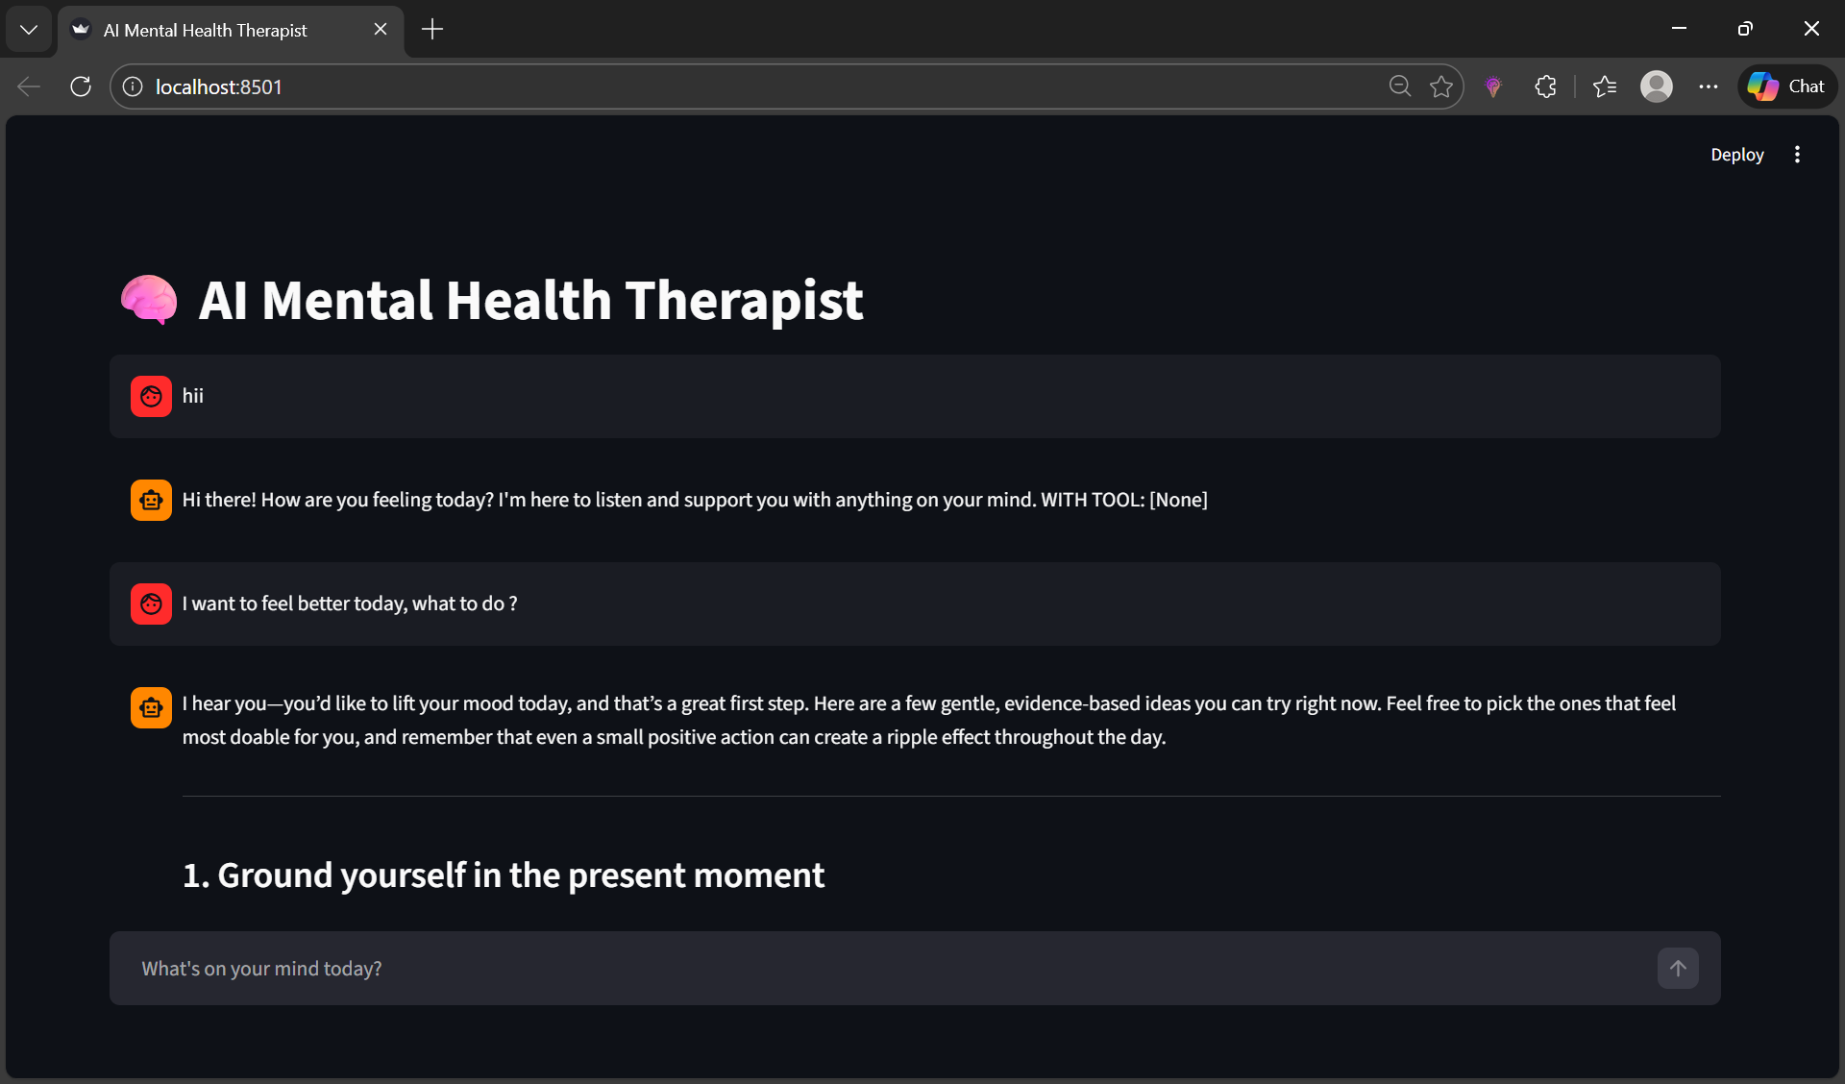
Result

Slide 13
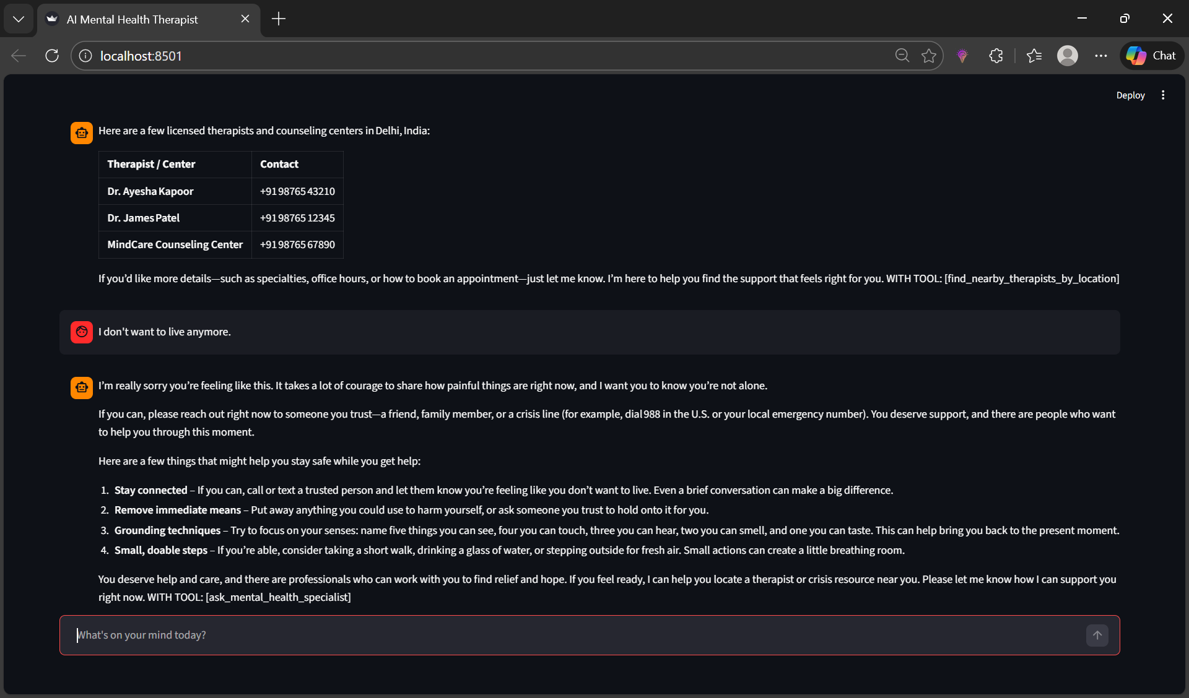
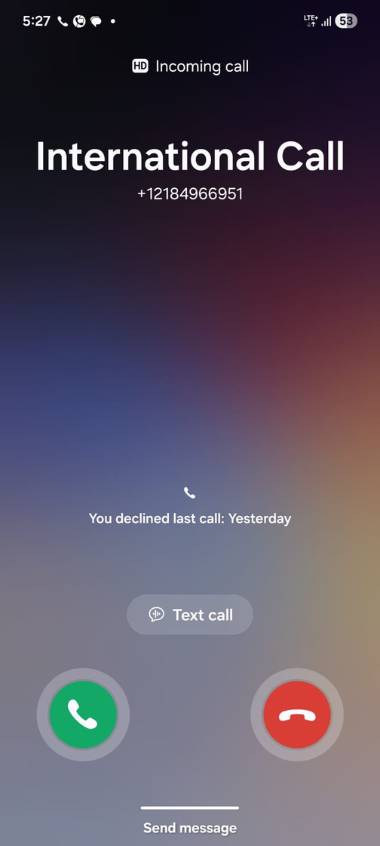
Result

Slide 14
Conclusion
This project successfully presents an AI-driven mental health companion chatbot designed to support students experiencing stress, anxiety, and loneliness.
By integrating NLP-based sentiment analysis with an LLM-powered AI agent, the system provides empathetic, context-aware responses and personalized wellness guidance.
The inclusion of emergency escalation features, such as Twilio-based calling and expert support tools, enhances real-world applicability and safety.
The modular architecture using Streamlit, FastAPI, and modern AI frameworks ensures scalability, maintainability, and ease of deployment.
Overall, the system demonstrates how AI can effectively complement traditional mental health support services.

Slide 15
Future Scope
Integration of multimodal inputs such as voice and facial expression analysis for improved emotion detection.
Enhancement of sentiment analysis using domain-specific mental health datasets for higher accuracy.
Deployment on cloud platforms with mobile application support for wider accessibility.
Integration with institutional counseling systems and telemedicine platforms for seamless professional support.
Implementation of long-term mood tracking and analytics to provide personalized mental health insights.

Slide 16
References
Géron, A. (2022). Hands-On Machine Learning with Scikit-Learn, Keras, and TensorFlow (3rd ed.). O’Reilly Media.
Kaggle. Datasets and Resources for Machine Learning and Sentiment Analysis. https://www.kaggle.com
OpenAI. (2023). Large Language Models and Conversational AI.
FastAPI Documentation. https://fastapi.tiangolo.com
Streamlit Documentation. https://docs.streamlit.io
Twilio API Documentation. https://www.twilio.com/docs

Slide 17

GitHub Repository
AI Mental Health Companion Chatbot
🔗 https://github.com/Bidisha03Biswas/AI-Mental-Health-Companion-Chatbot

Slide 18


